Slide 1

No Peak Gym
A Fitness center for the whole athlete

Slide 2
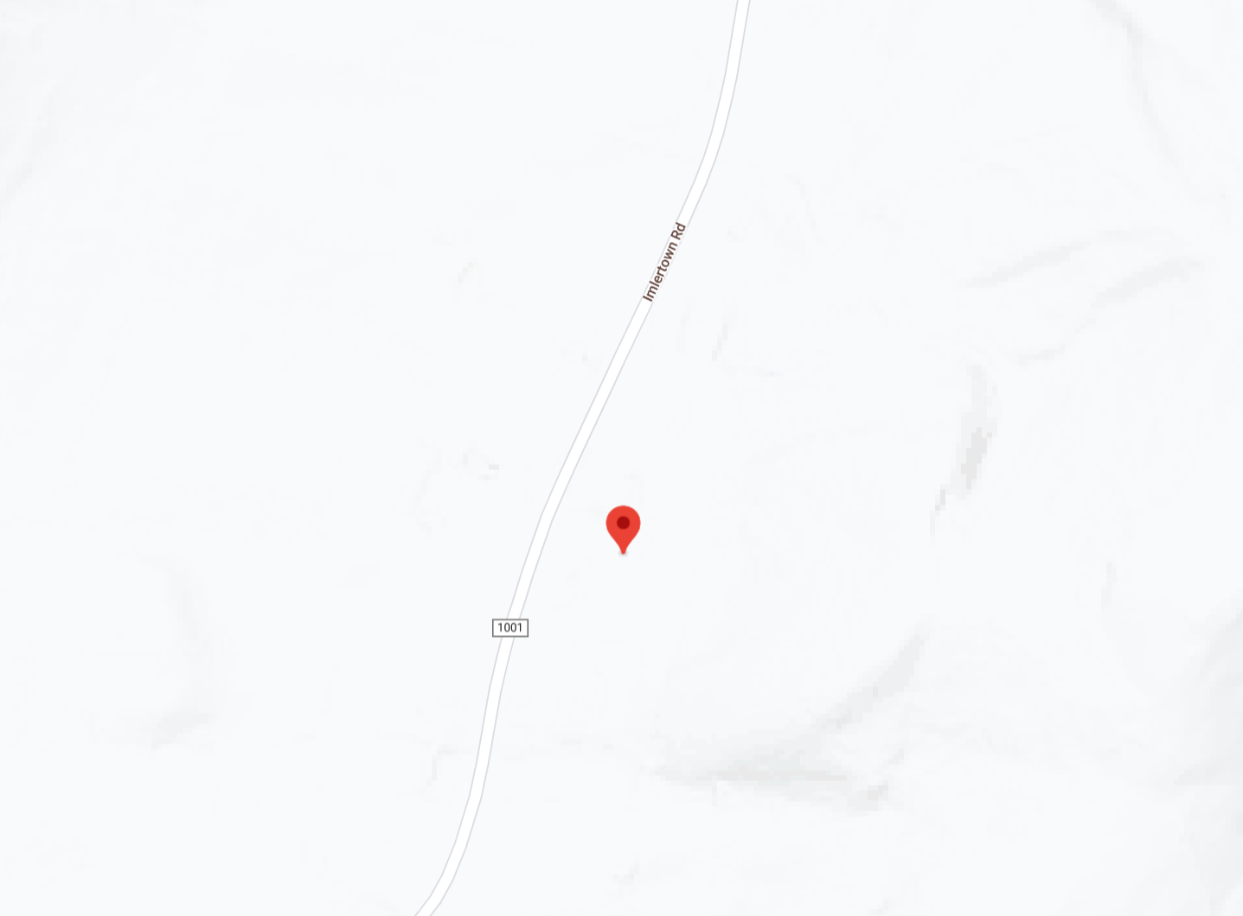
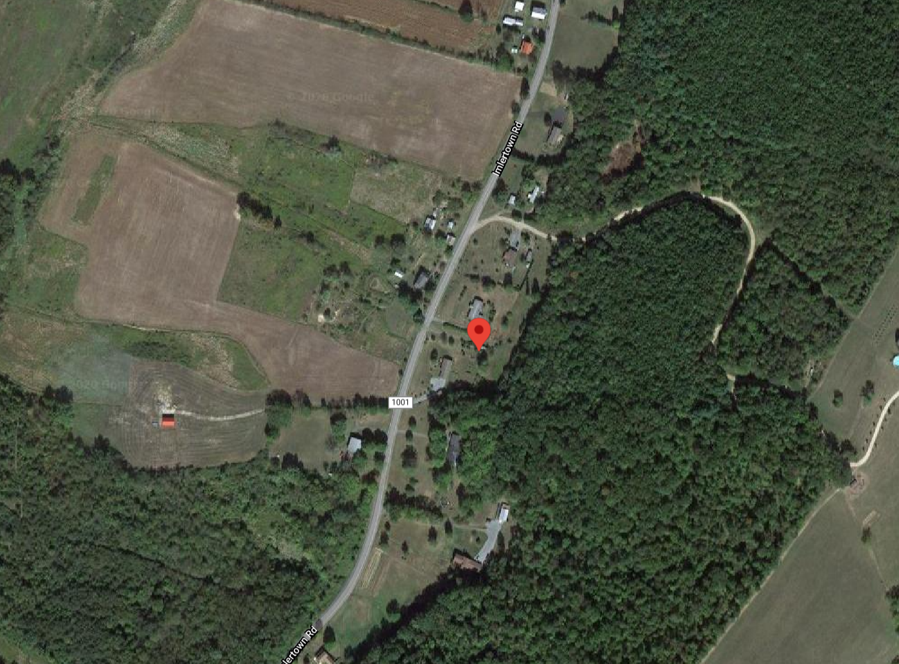
Overview
No Peak gym is a high-rise athletic rehabilitation center and gym. It is composed of a main building and an Multi-Sport athletic dome. The high-rise has a footprint of 1000ft x 600 ft and the dome has a footprint of 2000 ft x 2000ft. The lot size is much larger than the combined footprints of the facilities, so expansion is achievable without purchasing extra land.
Proposed Location:
Address: 1228 Imlertown Rd, Bedford, PA 1522
List Price: $28,000
Lot Size: 3.13 Acres
Location Features: Wooded Hilly landscape perfect for outdoor endurance training and provides a dynamic scenic environment

Slide 3
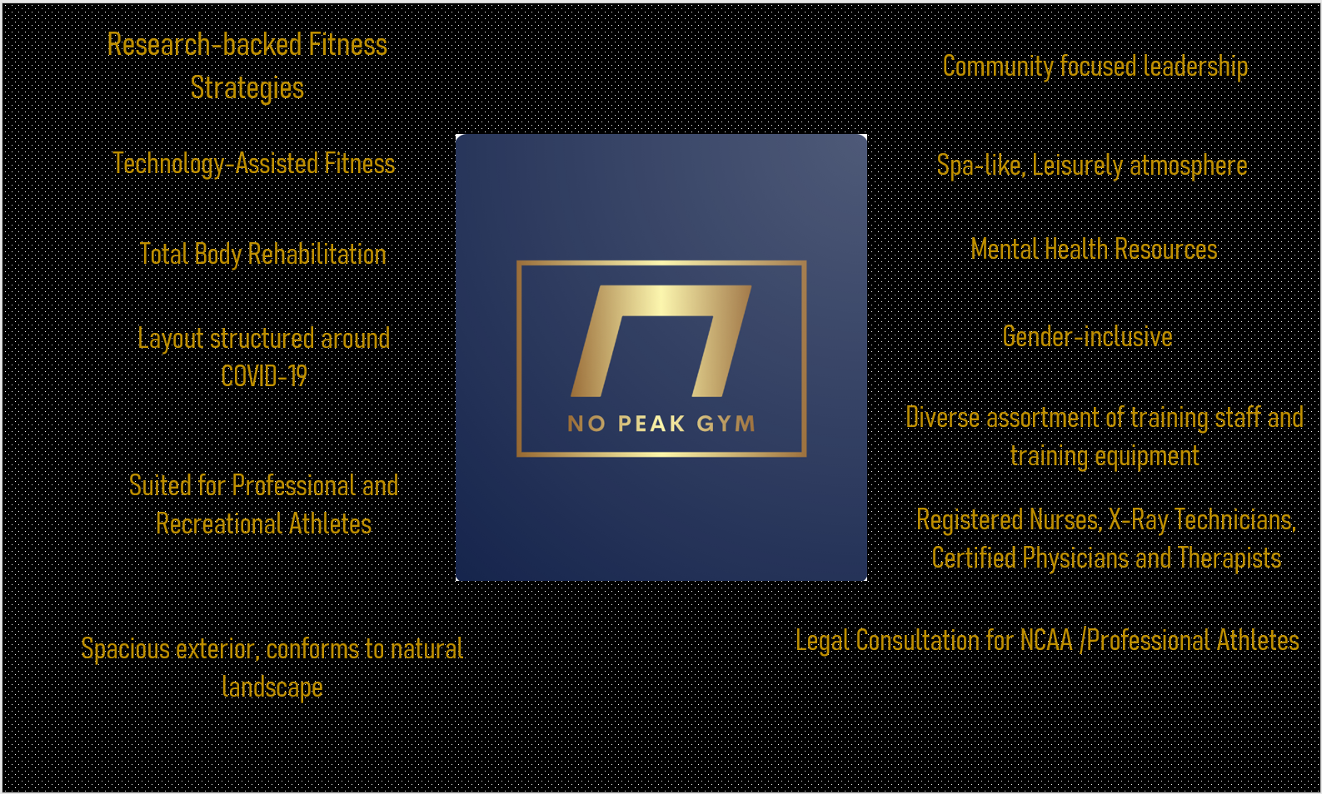
Considerations
The design started as a notebook sketch and was modeled using Fusion360. James Develin’s goals, COVID-19 protocols and standard athletic rehabilitation practices were take into consideration. My goal was to encompass the following ideas through the facility’s architecture, layout and culture.

Slide 4
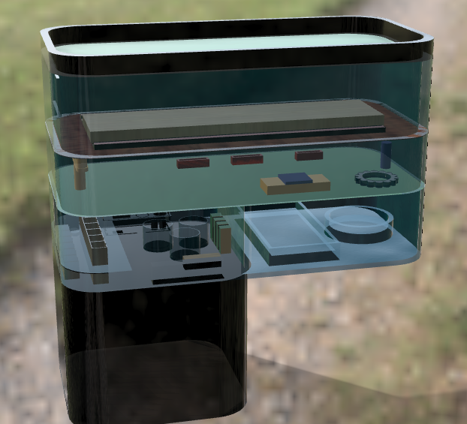
Design Concept
The main building is 4 stories with a green roof that can be used for outdoor group classes. The ceiling heights are 18’ except the first floor, which is 36 ft. Natural light is a major design feature as the floors are wrapped in a blue-tinted glass. The building design promotes transparency in training practices, but the locker rooms and spa facilities are private. No Peak Gym has a spa-like culture to precisely treat the athlete’s bodies as they work to surpass their goals. The staff consists of community leaders, registered nurses, X-Ray technicians and qualified physicians and therapists to assist the athletes through recovery.

Slide 5
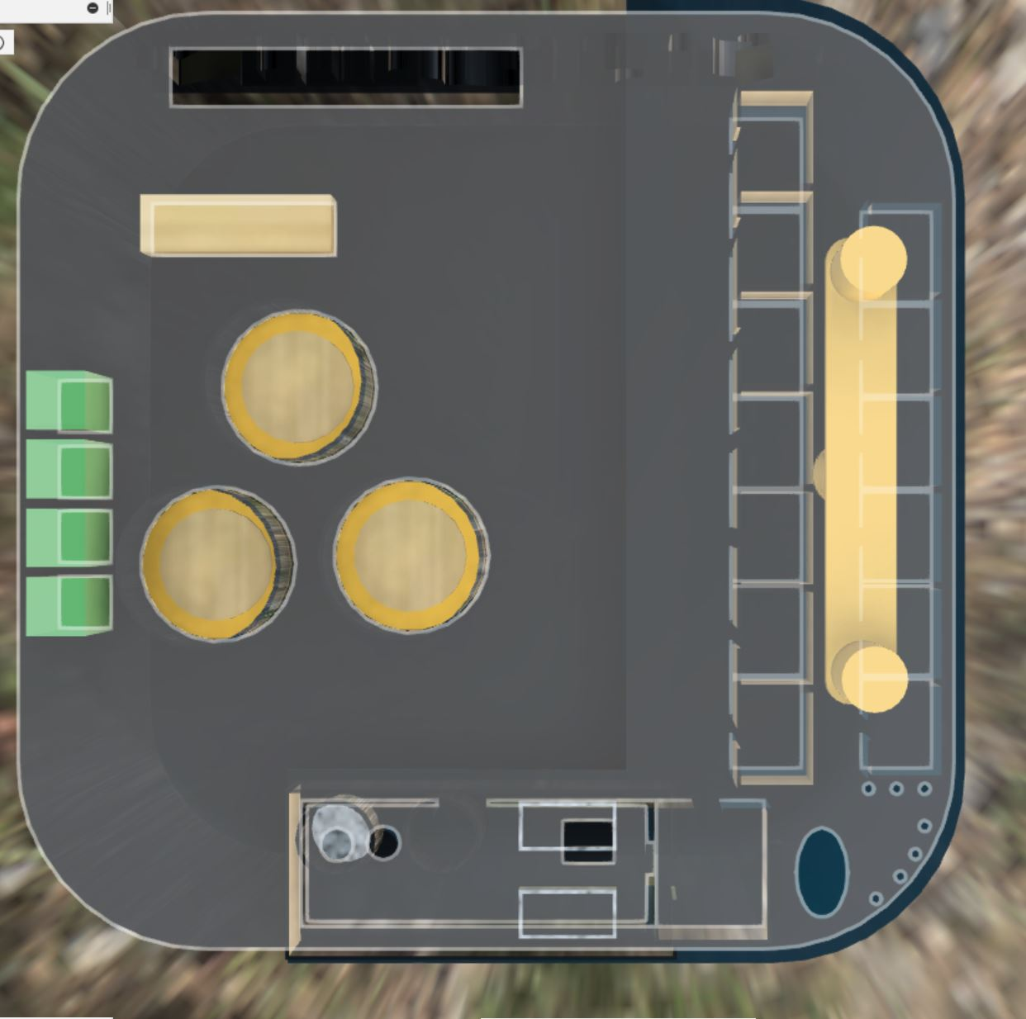
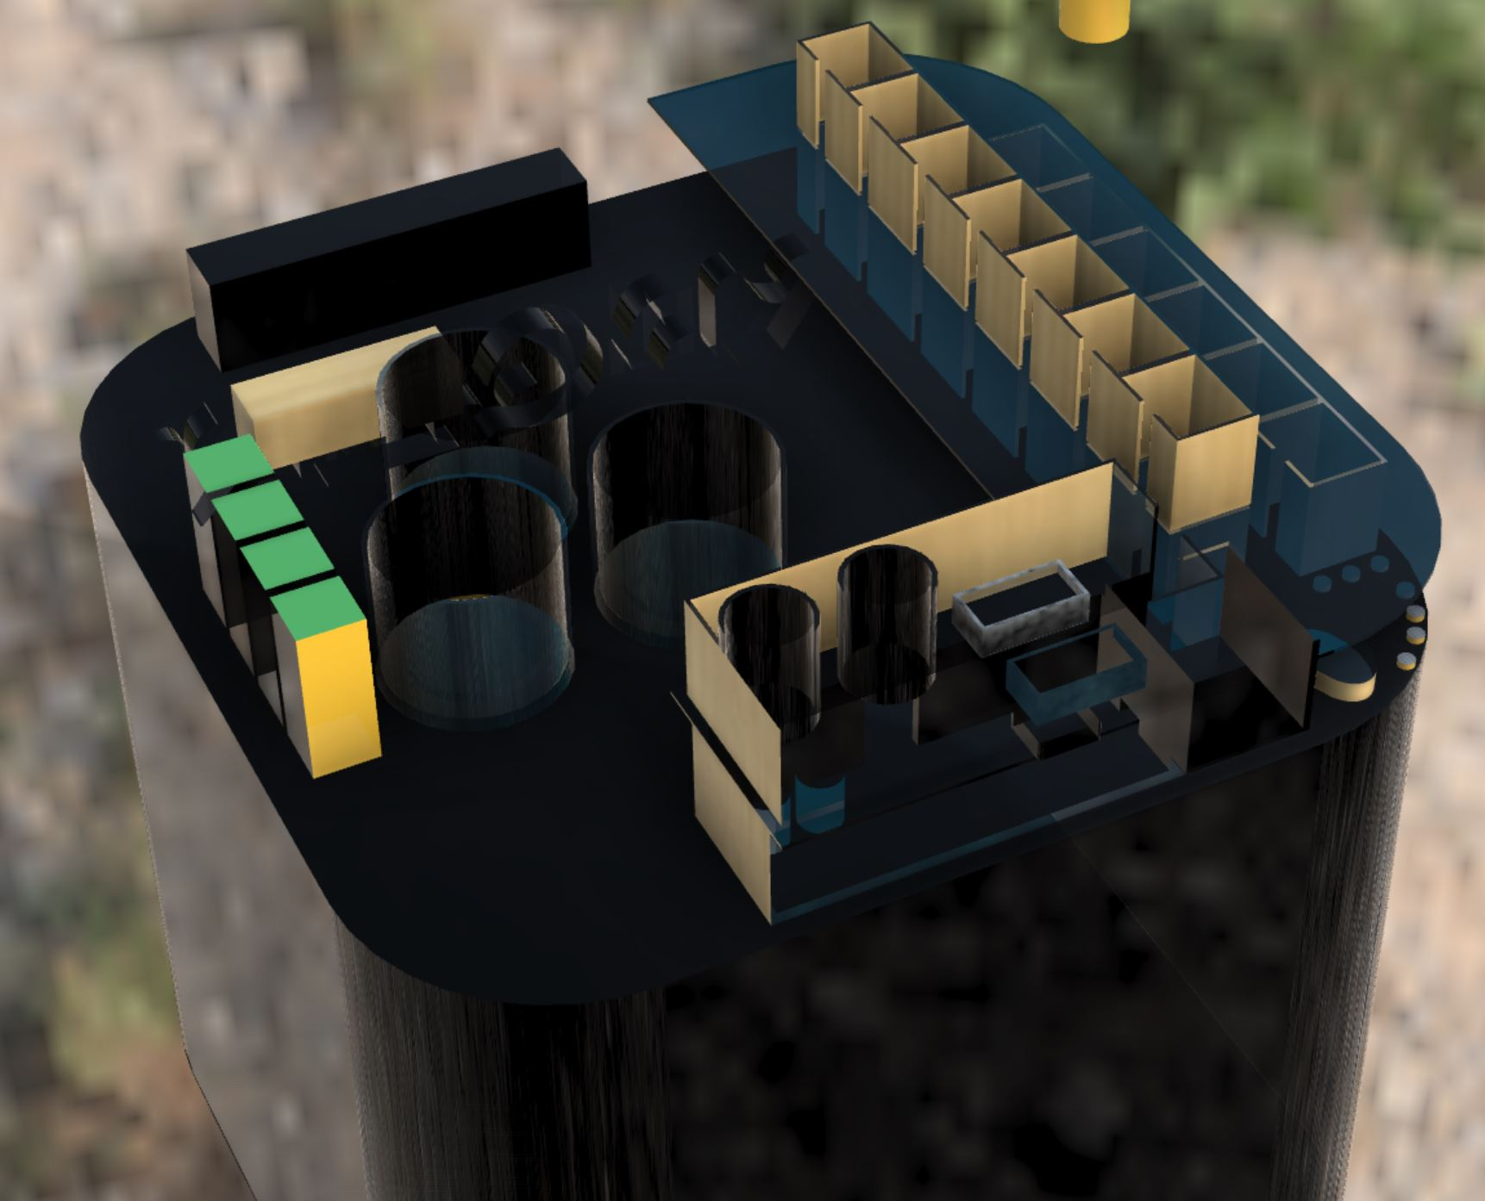
First/Second Floor
Glass Walls promotes transparency
Changing Rooms have bamboo walls to enable privacy.
Cafeteria tables are enclosed with plexiglass to prevent spread of particles between tables
Cafeteria has space for Chef/Vendors and healthy Vendor Machines
Locker Rooms
Men’s (1st Floor)
Women’s (2nd Floor)
Cafeteria
500’
Spa (Mud Bath
Cryochamber)
Waiting Room
600’

Slide 6
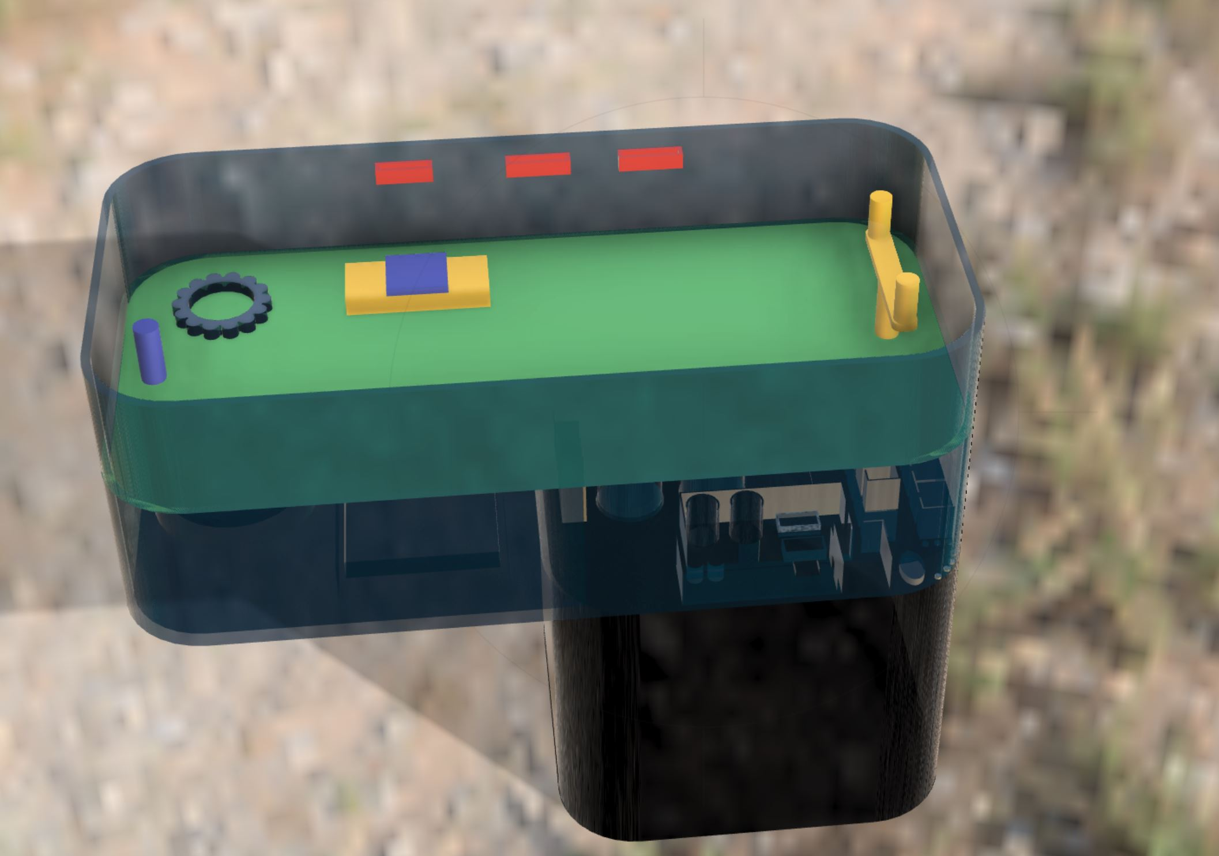
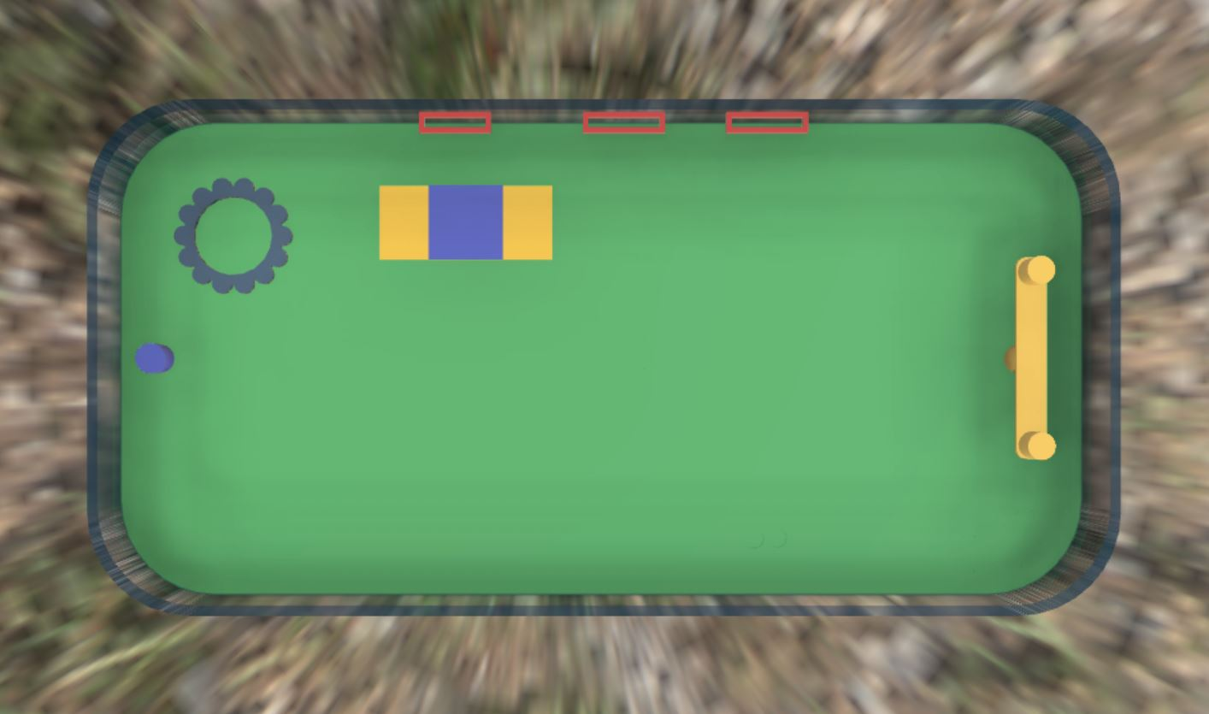
Third Floor
Pullup Bars
Tire
Field Goal
600’
1000’
Flooring is Artificial Turf. Indoor Football field includes Pull-Up Bars, a tire, 1 field goal and Step Decks. Additional Equipment can be added for training sessions.

Slide 7
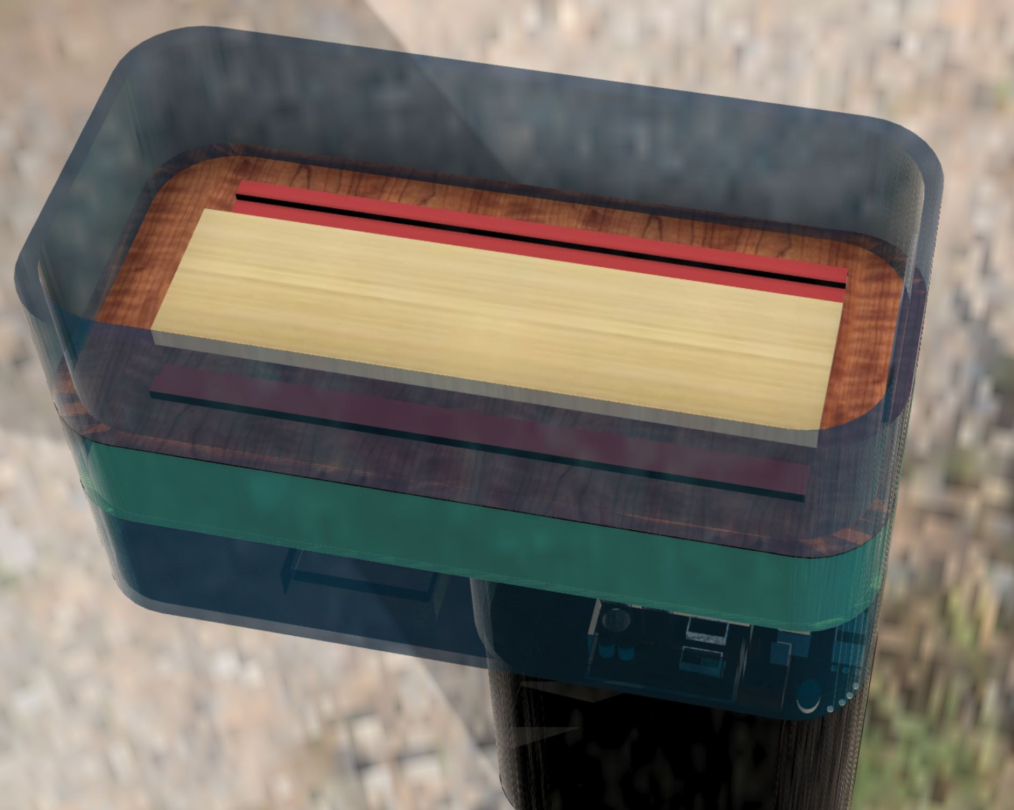
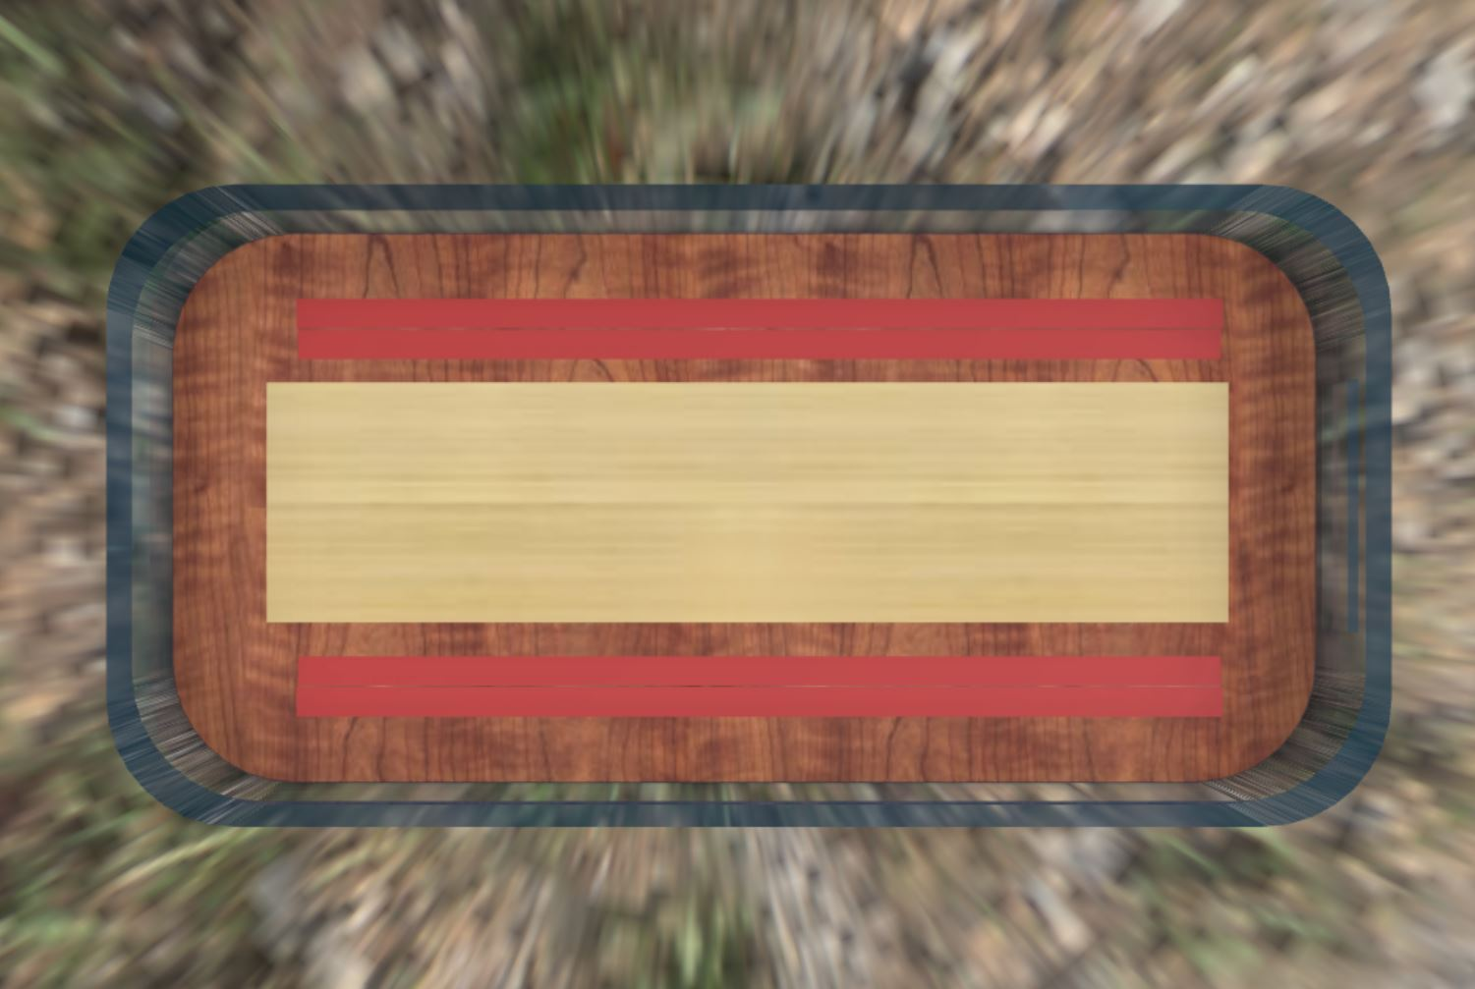
Fourth Floor
Meeting Room
600’
1000’
Meeting Room for Corporate Occasions and Meetings with Athletes and their Coaches. Rooms can be booked with front desk or via the Gym App

Slide 8
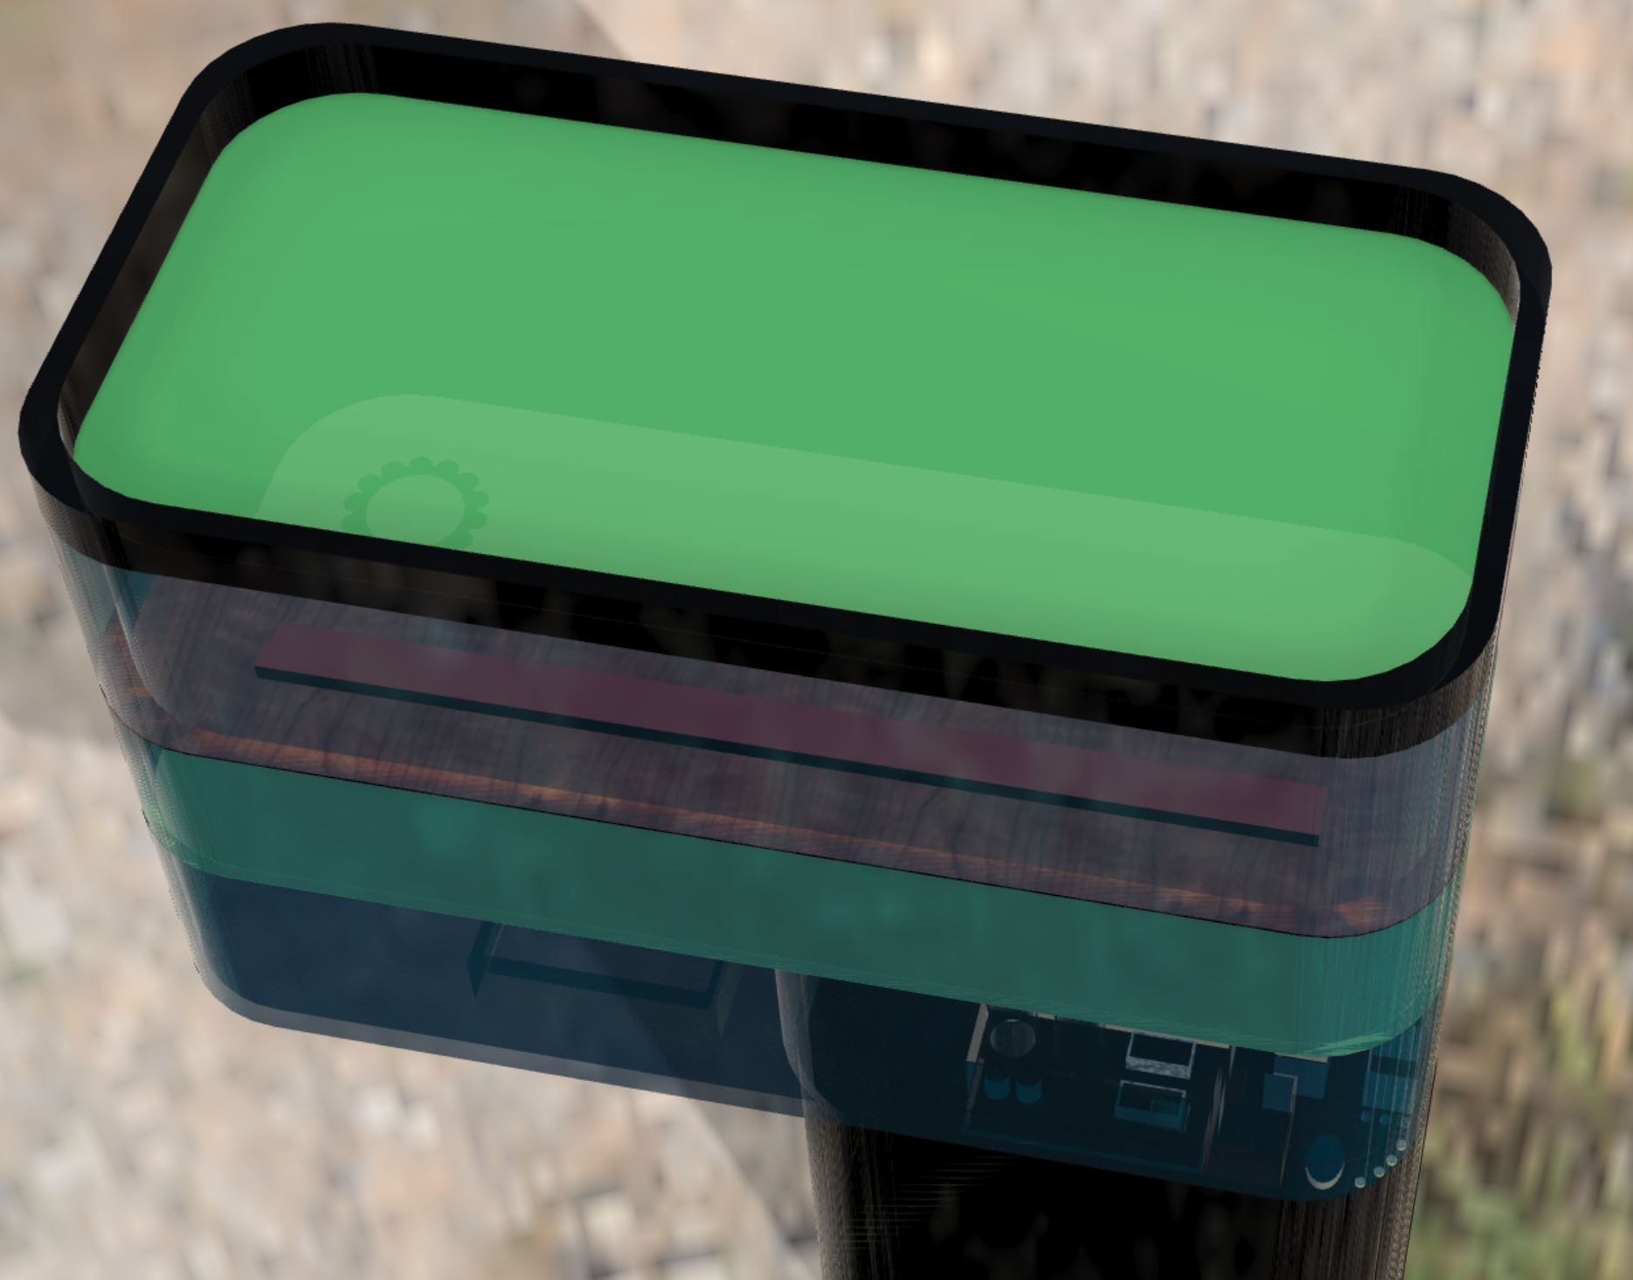
Roof Floor
Green Floor for Outdoor Group Classes. When classes aren’t taking place, members can use space for personal exercise.
1000’
600’

Slide 9
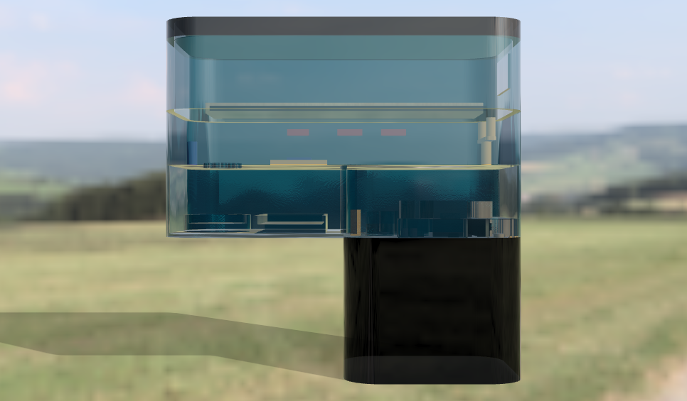
Summary
Thank you for your time and consideration.
Please email feedback and concerns: gamegirl900.sp@gmail.com

