Slide 1
WHAT HAPPENS
WHEN PEOPLE WHO
CAN VOTE
DON’T VOTE?

Slide 2
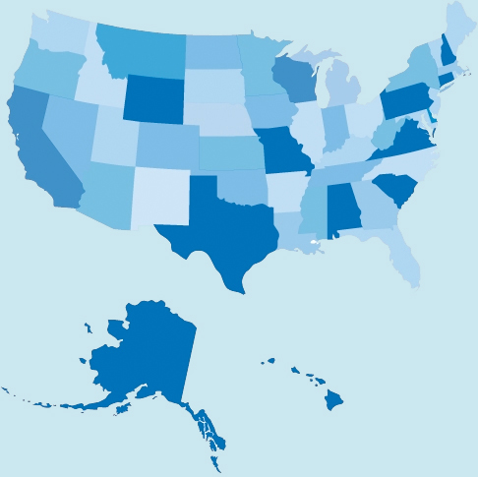
The total population of the US was 325,719,178 in 2017

Slide 3

Here’s a graphic where each figure represents about 30 million people.
30 x 10 = 300,000,000 or 300 million people
(the approximate US population).

Slide 4

But not everyone is allowed to vote…

Slide 5
WHO
CAN’T VOTE?

Slide 6


PEOPLE UNDER 18 CAN’T VOTE
US Census says there were about 73,612,534 minors in the US in 2017

Slide 7
THREE GROUPS OF PEOPLE WHO ARE OVER 18 YEARS OLD
CAN’T VOTE….

Slide 8
GROUP ONE:
SOME PEOPLE IN THE PRISON SYSTEM
CAN’T VOTE
The total number of people who can’t vote due to a felony conviction has been estimated at 6.1 million – but many more people who have been convicted of a felony in the past don’t realize that they are actually eligible to vote now.

Slide 9
GROUP TWO:
PEOPLE JUDGED “MENTALLY INCOMPETENT”
CAN’T VOTE
Over half the states in the US have laws that limit people from voting if they have been ruled "mentally incapacitated," or “incompetent” by a court. This includes people in institutions and people with appointed guardians. Total figures are hard to gauge.

Slide 10
GROUP THREE:
PEOPLE WHO ARE DOCUMENTED NON-CITIZENS
CAN’T VOTE
There are 10 million documented non-citizens in the US. (The number of undocumented non-citizens has been estimated at about 12 million - but they are not included in the US Census Bureau’s total population figure.)

Slide 11
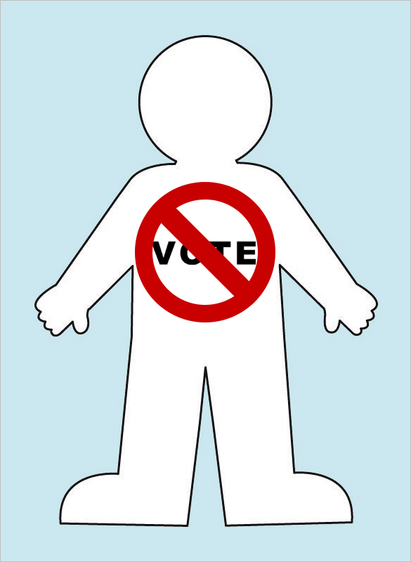

So…PEOPLE OVER 18 WHO
CAN’T VOTE total one figure:
some felons in the prison system
judged “mentally incompetent”
documented non-citizens

Slide 12

This leaves 7 figures - over 200 million eligible US voters!
WHAT DID THEY DO IN THE 2016 ELECTION?

Slide 13
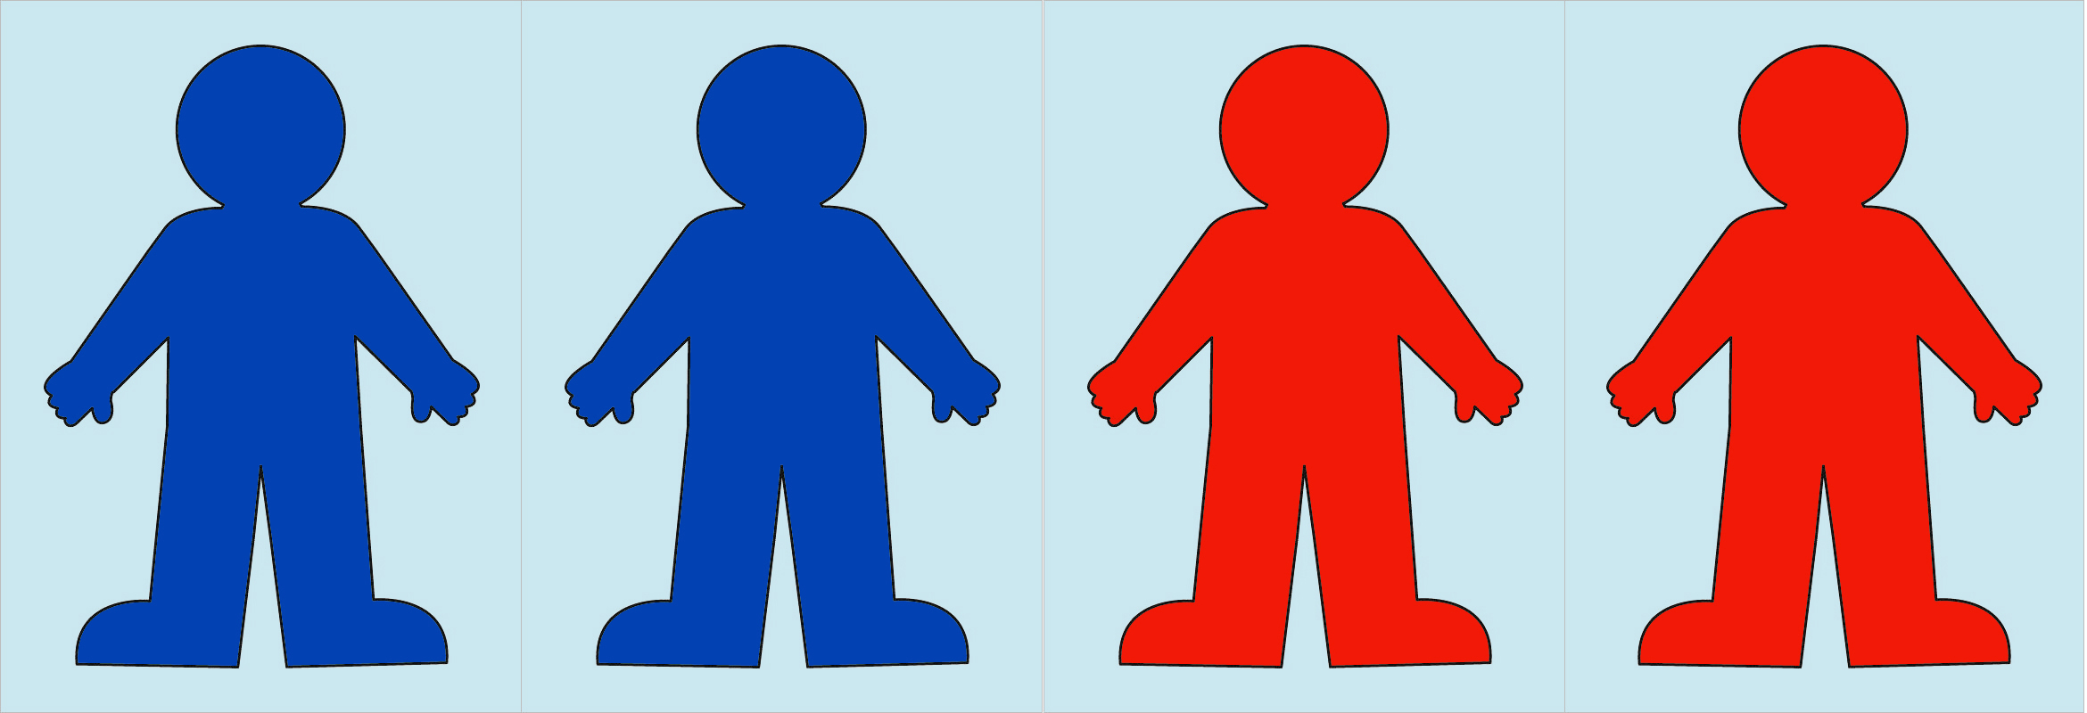
136,435,538 Voted!
48.5% of the total voters (65,853,516) voted Democratic
46.4% of the total voters (62,984,825) voted Republican
5.1% of the total voters (7,597,197) voted for other parties or wrote in names

Slide 14

So let’s review…
We have people who can’t vote….People who voted….and over 90 MILLION nonvoters?

Slide 15
Why don’t people vote?
?

Slide 16
I can't get to the polls
I'm not into politics
I don’t know enough about the candidates or the issues
I don't like these candidates
My vote won't count
Registration is too hard
The weather is too bad
Nothing in politics can change
What’s your response to these
statements?

Slide 17
WHAT HAPPENS
WHEN PEOPLE WHO
CAN VOTE
DON’T VOTE?

Slide 18
Your vote matters!
After an extremely close race in the Virginia House of Delegates (District 94 - Newport News), Democrat, Shelly Simonds was declared the winner by just one vote. Another ballot was found which supported her opponent, Republican David Yancey. After judges rejected Democrats’ challenge of a single vote, the race was declared a tie and decided by drawing lots. Yancey was declared the winner in January, 2018.
The closest election in Senate history was the 1974 New Hampshire race which ended in a two-vote margin of victory after several recounts. The ensuing challenges lasted eight months and ended with a full senate investigation and the ordering of a new election. The Democratic candidate, John Durkin, then won by a wider margin.

Slide 19
What would happen if EVERYONE who could vote did vote?

Slide 20
Sources
US Population figures are from US Census Bureau, July 2017: https://www.census.gov/quickfacts/fact/table/US/PST045217
Information on Felon Voting Rights are from the National Conference of State Legislatures: http://www.ncsl.org/research/elections-and-campaigns/felon-voting-rights.aspx
The Sentencing Projects reports that 6 million Americans can’t vote due to a felony conviction: https://www.sentencingproject.org/issues/felony-disenfranchisement/
The Bazelon Center for Mental Health Law has a Voting Rights Guide: http://www.bazelon.org/wp-content/uploads/2017/11/2016_Voter-Guide-Plain-Language.pdf
Pew Trusts’ article on mental incompetence: https://www.pewtrusts.org/en/research-and-analysis/blogs/stateline/2018/03/21/thousands-lose-right-to-vote-under-incompetence-laws
Migration Policy Institute’s statistics on US migrants: https://www.migrationpolicy.org/article/ frequently-requested-statistics-immigrants-and-immigration-united-states
Voting figures for the 2016 national election are from CNN: https://www.cnn.com/election/2016/results
Slideshow on close elections from CNN: https://www.cnn.com/2012/10/11/politics/gallery/closest-us-elections/index.html

Slide 21
Comments: austinactivism@gmail.com

